Slide 1
Cdc operated wastewater treatment plant (WWTP) SITE Specific safety induction

Slide 2
Site induction procedure

Slide 3
INTRODUCTION

Slide 4
Lawrence WWTP – Site Access

Slide 5
Lawrence WWTP – Hazards

Slide 6
Lawrence WWTP – PPE and Emergency Assembly point

Slide 7
Waihola WWTP – Site Access

Slide 8
Waihola WWTP – Hazards

Slide 9
Waihola WWTP – PPE and Emergency Assembly point

Slide 10
Balclutha WWTP – Site Access

Slide 11
Balclutha WWTP – Hazards

Slide 12
Balclutha WWTP – PPE and Emergency Assembly point

Slide 13
Kaitangata WWTP – Site Access

Slide 14
Kaitangata WWTP – Hazards

Slide 15
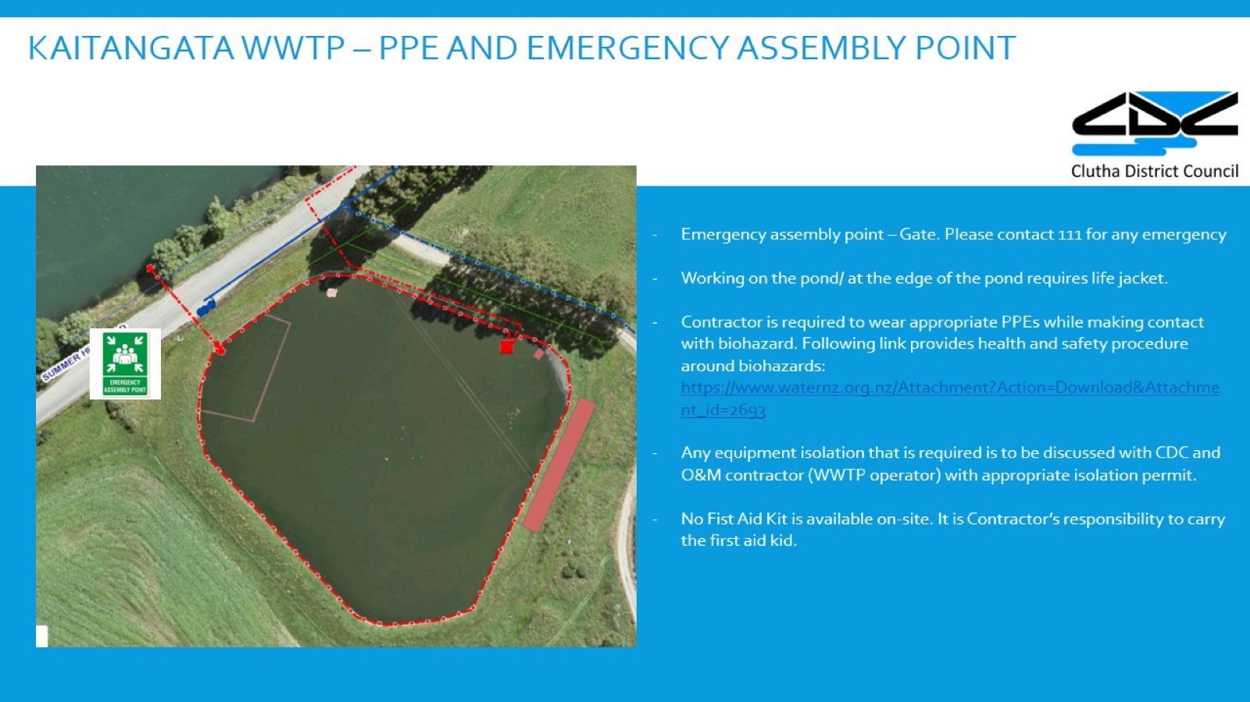
Kaitangata WWTP – PPE and Emergency Assembly point

Slide 16
Stirling WWTP – Site Access

Slide 17
Stirling WWTP – Hazards

Slide 18
Stirling WWTP – PPE and Emergency Assembly point

Slide 19
Kaka Point WWTP – Site Access

Slide 20
Kaka Point WWTP – Hazards

Slide 21
Kaka Point WWTP – PPE and Emergency Assembly point

Slide 22
Owaka WWTP – Site Access

Slide 23
Owaka WWTP – Hazards

Slide 24
Owaka WWTP – PPE and Emergency Assembly point

Slide 25
Clinton WWTP – Site Access

Slide 26
Clinton WWTP – Hazards

Slide 27
Clinton WWTP – PPE and Emergency Assembly point

Slide 28
Tapanui WWTP – Site Access

Slide 29
Tapanui WWTP – Hazards

Slide 30
TAPANUI WWTP – PPE and Emergency Assembly point

Slide 31
Heriot WWTP – Site Access

Slide 32
Heriot WWTP – Hazards

Slide 33
Heriot WWTP – PPE and Emergency Assembly point

Slide 34
Key contacts

